Slide 1
LIBRA the programming language
SHIVAM SHARMA
2000300130117
IT-C

Slide 2
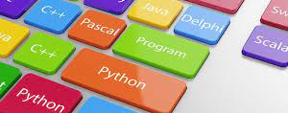
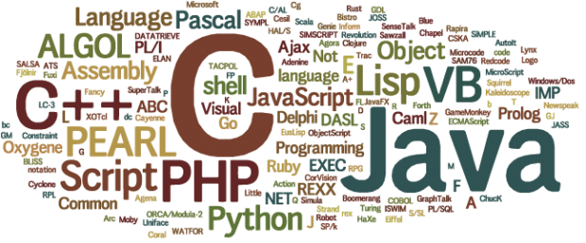
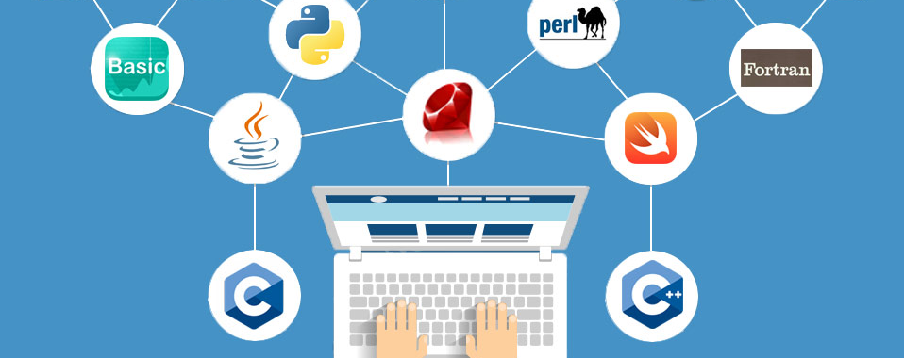
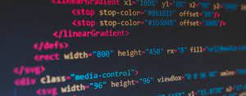
PROGRAMMING LANGUAGE
A programming language is a formal language comprising a set of strings that produce various kinds of machine code output. It Is used in computer programming to implement algorithms.
In This Project A Programming Language Is Developed Using Python.

Slide 3
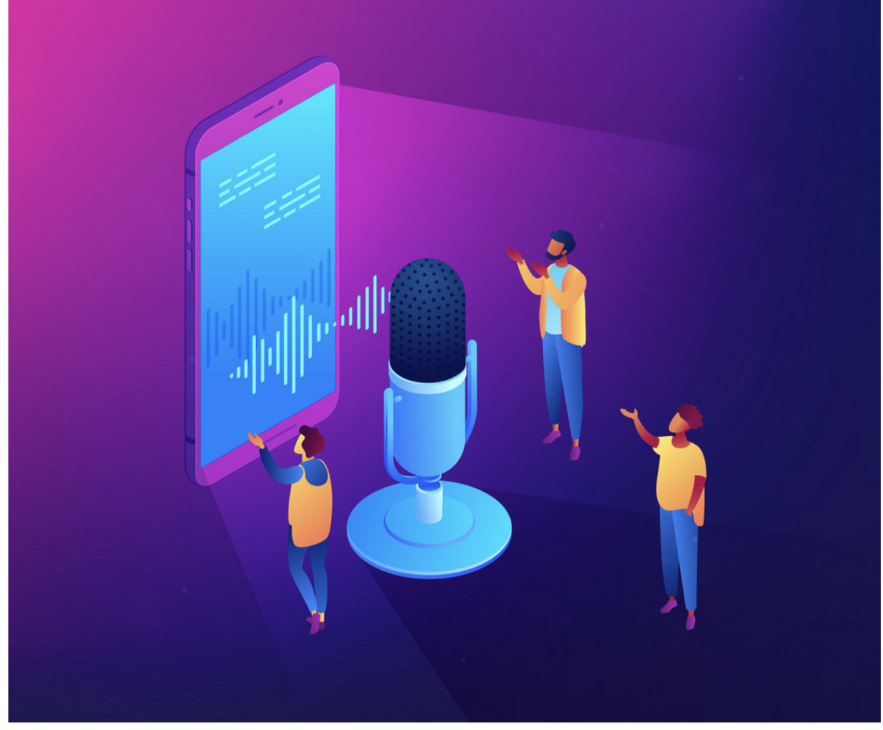

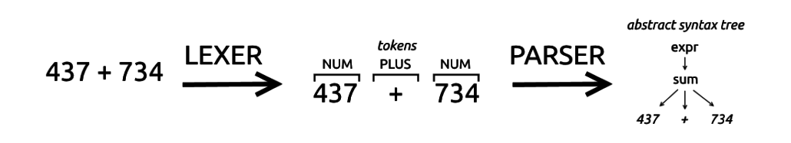
HOW PROGRAMMING LANGUAGE WORKS?
Firstly, Our Code Is Tokenized By The Help Of Lexer.
Then Parsing Is Done By The Help Of Parser.
Lastly, It Will Be Converted Into A Machine Code.

Slide 4
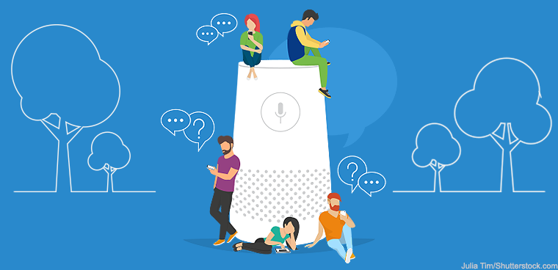

TECH STACK
PYTHON
Regex

Slide 5
OPERATIONS OF LIBRA

Slide 6
MATHEMATICAL OPERATIONS
ADDITION :- >>5+3
8
SUBTRACTION :- >>7-3
4
MULTIPLICATION :- >>6*5
30
DIVISION :- >>8/4
2
MODULO :- >>5%2
1
POWER :- >>5^2
25

Slide 7
VARIABLES
SYNTAX:- KEYWORD IDENTIFIER = <expr>
>>var x=5
>>x
5

Slide 8
COMPARISON & LOGICAL OPERATORS
EQUAL :- >>5==3
FALSE
LESS THAN :- >>1<3
TRUE
GREATER THAN :- >>6>5
TRUE
LESS THAN EQUAL TO :- >>8<=8
TRUE
GREATER THAN EQUAL TO :- >>1>=2
FALSE

Slide 9
CONDITIONAL STATEMENTS
If_expr:
>> if 4==4 then 8
8
else_expr:
>> if 8==4 then 8 else 4
4
elsif_expr:
>> if 4==4 then 8 elsif 8>4 then 4 else 2
8
4

Slide 10
LOOPS
From loop(for):
>>var result=1
>>from i = 1 to 6 then var result = result*i
120
Until loop(while):
>>var i=0
>>until i<100 then var i = i+1
100

Slide 11
FUNCTIONS
>>fun hello()
print("hello world")
just
>>hello()
hello world

Slide 12
THANK YOU

